Slide 1
Mobility (and) practices: identifying the ‘anchors’ of daily (travel) routines
Mobility as Practice session,
RGS-IBG Conference,
Thursday 29th August 2013
Notes:
Paper coming our of on going research councils energy programme funded project – say more minute
Paper is attempt to examine how social theories of practice can be used to understand everyday mobility.

Slide 2
7 Universities, EPSRC-RCUK funded
6 Work Packages, quantitative and qualitative, academic, organisation and policy facing
WP2: Lancaster and Brighton ‘ethnographic’, longitudinal, multiple data type research on everyday life and travel and disruptions to it

Slide 3
The context: the automobile commute
Transport is responsible for somewhere in the region of 20% of global carbon dioxide emissions
40% of UK transport-related carbon emissions come from cars
Routine and short journeys significant proportion of these, although commutes getting longer.
Car share of commutes 71% (UK), 42% (London)
The well-known conundrum: how to transition towards lower carbon commuting?

Slide 4
Previous work on the commute
The commute in traditional transport research: one of the three main ‘trip’ categories;
it is seen as a ‘problem’ primarily in terms of time wasted and lost, as a business/efficiency loss, and as a cause of unhappiness and stress at the personal level, (Lyons and Chattergee 2008);
a number of solutions have been proposed to ‘deal’ with it including flexible working, home-working, and largely behavioural change approaches to convince people to change transport mode.
i.e., studies tend to focus on the commute itself and the work(place) associated with it

Slide 5
Our approach
We view the dominance of the automobile commute as being based on:
The ‘co-evolution’ (Watson 2012) of automobility and spatial dispersed lifestyles/practice bundles in (socio-technical) systems of practice, and linked to this...
The encroachment of automobile logics (the meanings and affordances of driving as a practice) into the commute and many other mobility related practice fields
This, we claim, means intervening to drive low carbon transitions requires work inside and outside of the commute itself – in the systems of practice that sustain the dominance of automobility

Slide 6
The commute-automobility nexus
Speed and efficient use of travel time
Ease and straightforwardness
“Home – Work – Slough – Used car due to train cost and ease” (L31 travel diary: multiple entries)
Interviewer: “why do you drive then?
Participant: Yes, well – ritual ... I just want to be able to get into the car and get there as quickly as possible.”(L90)
“It's just easier with a car and I can come and go at what time I want.” [which?]
Notes:
The starting point for our argument is that what has become normalised as the commute is in many ways a form of mobility that reflects the affordances and meanings of elite automobility.
Over next few slides outline various dimensions of this, with quotes from our participants. Don’t have time to read all but glance and get sense of how people understand their commute.

Slide 7
Speed and efficient use of travel time
Ease and straightforwardness
Control of timings and route
Flexibility for mobility needs during the working day
“What I don't like about it [the train] is it's a fixed time ... So that's what I don't like. It's 4.20. With a 10 minute walk from the school it doesn't give any flexibility.” (L20)
“Last night for example I went down to Chorley on a Managing Temporary Contracts course at 3.30 till 6 o'clock ... so obviously I needed my car for that, to go down to Chorley.” (L30)

Slide 8
Speed and efficient use of travel time
Ease and straightforwardness
Control of timings and route
Flexibility for mobility needs during the working day
Comfort (indoor/domesticated)
Privacy (hell is other people)
“and managed to get on - and even get a seat, but clearly a number of people were left behind, and the train itself was, I suspect, dangerously crowded” (L20)
“I don’t want to be on the chavvy buses later! ...I have a real thing about sniffers ... And people who have their Walkman’s on... And the language that comes out when you get onto these buses is just ... sort of non-university people” (Mary)
Notes:
Note how stories often constructed by comparing car to other means of mobility

Slide 9
Speed and efficient use of travel time
Ease and straightforwardness
Control of timings and route
Flexibility for mobility needs during the working day
Comfort (indoor/domesticated)
Privacy (hell is other people)
Porterage of work-related materials
“I'd usually be using my car because I needed to transport books and stuff like that.” (L150)
“I will be driving more as the shows get closer, though, as I will have increasing amounts of props etc to carry.” (L20)

Slide 10
Speed and efficient use of travel time
Ease and straightforwardness
Control of timings and route
Flexibility for mobility needs during the working day
Comfort (indoor/domesticated)
Privacy (hell is other people)
Porterage of work-related materials
Combination with other practices (school run, shopping, recreation, keeping fit)
“I would be dropping them off at ... school so I needed the car to get from A to B ... to get to work on time.” (L110)
“I tend to leave about quarter to six, drive into town, park at Sainsbury’s ... and then drive home after the gym.” (L100)

Slide 11
The commute as a practice with logics embedded in automobility
Speed and efficient use of travel time
Ease and straightforwardness
Control of timings and route
Flexibility for mobility needs during the working day
Comfort (indoor/domesticated)
Privacy (hell is other people)
Porterage of work-related materials
Combination with other practices (school run, shopping, recreation, keeping fit)
So what are the implications for attempts to drive low carbon transitions?

Slide 12
Low-carbon-commuting
As requiring the abandoning of existing meanings of commuting?
Not necessarily…
Speed and efficient use of travel time
Ease and straightforwardness
Control of timings and route
Flexibility for mobility needs during the working day
Comfort (indoor/domesticated)
Privacy (hell is other people)
Porterage of work-related materials
Combination with other practices (school run, shopping, recreation, keeping fit)

Slide 13
Speed and efficient use of travel time
“with the traffic in Lancaster it's easily a half hour. It shouldn't be because it's only 8 miles, but it can be. Whereas I say, cycling I can do it in almost the same amount of time.” (L20)
“Driving takes me an hour and fifteen. There are innumerable buses, tractors, you name it ... The train takes 55 minutes with a 10 minute walk at the other end” (L20)
“And also I tend to use the train because I can work on it, read or phone or whatever. So that's what I like about the train, the price, and the use of time.” (L20)

Slide 14
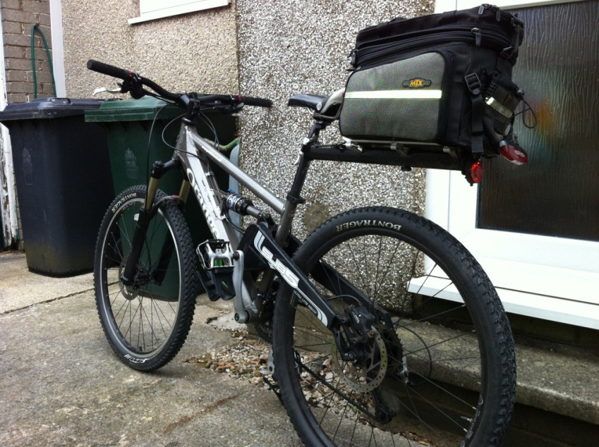
Porterage of work-related materials
“my bike (It looks rather ugly with
the rack and bag on the bag but
functionality wins for commuting!!) (L80)

Slide 15
But…substituted logics matter when elements of the automobile commute are absent
Health -
“in a management job, he was sat all day, it was his only way of exercising, so health but also money” (L30)

Slide 16
But…substituted logics matter when elements of the automobile commute are absent
Health -
Cost
“he went to work by train, it was actually easier for him to do that really than trying to park the other end and, you know, yeah, and it made it more economical to just have the one car”(Adrienne)

Slide 17
But…substituted logics matter when elements of the automobile commute are absent
Health -
Cost
Relaxation/transition to/from work
“when I cycled it was too close and I needed to walk to have extra time ... I never had that time out to de-stress before coming to work or from work” (L81)

Slide 18
But…substituted logics matter when elements of the automobile commute are absent
Health -
Cost
Relaxation/transition to/from work
Outdoor stimulation (fresh air)
“a blast of fresh sea air first thing in the morning... cycle to work and feel energised by that ... you feel awake and ready to take on the day’s tasks, so a nice way to start the day” (Adam)

Slide 19
But…substituted logics matter when elements of the automobile commute are absent
Health -
Cost
Relaxation/transition to/from work
Outdoor stimulation (fresh air)
Environment

Slide 20
Implications
Behaviour change may have a role to play:
recruitment to low carbon means through recognition of low carbon commuting's parallels to the automobile;
recruitment through the building of the substituted logics
But…it will only have a small impact
Spectrum of Socio-technical systemic interventions needed
the commute is located in a system of practices (including schooling, recreation, shopping and other practices)
Connections to these other practices involve contingencies that render low carbon commuting and the achieving of many of the logics we outline difficult
Interventions need to address these contingencies that produce a system of practice
Notes:
In the paper we address these contingencies as the factors that make a difference between the affordances of cars and other transport modes.

Slide 21
Contingencies
personal (physical e.g. fitness)
spatial (e.g. the metric distances between practice sites)
infrastructural (rail or bus stops and route, in spatial proximity to home and workplace, parking spaces, cycle storage and showers)
competence based (scheduling the intersection of household, transport and institutional timetables – school run)
materials based (comfort, privacy, scheduling through the use of appropriate clothing or ‘involvement shields’, ‘reliability’ through pre-empting breakdown)
temporal (lies behind all others – tyranny of inflexible times)
Notes:
The inconvenience of parking in our data shows that immobility is important – particularly over short distances it can make all the difference to the perceived convenience of different modes.

Slide 22
Implications
Interventions beyond the individual – first focus on systemic factors that can reduce the contingencies for large numbers
Some contingencies cannot be resolved (corporeal, distances)
Some cannot be addressed by the individual (location of workplace, infrastructural provision)
The most viable interventions therefore address these and norms of practice , especially temporal scheduling.
Notes:
Not addressing the need for such cultural changes reduces the options for interventions.

Slide 23
Spectrum diagrams
Work
Least radical
Most radical
Parking for car-sharers - infrastructural
Mandate flexible hours - temporal
Reduce ‘core hours’ for business - temporal
Technology for flexible work provided by employer - material
Collectivised works transport - infrastructural
Late arrival accepted for low-carbon commuters - cultural
(Particularly low paid/low time flexibility) – responsibility for low-carbon commute shifts to employer - systemic

Slide 24
Spectrum diagrams
School
Least radical
Most radical
Flexible start time for low carbon parents - temporal
Mandate local school attendance – choice
Mandate cycle proficiency – personal competence
Demand responsive transport - infrastructure
Carbon footprint of school run responsibility shifts to school - systemic
No car stopping or dropping near schools - infrastructure
Walking and cycling ‘buses’ – slowing traffic – addressing risk
‘Cycle to school’ funds

Slide 25
Reinventing ‘the commute’
Changing work practices necessarily causes changes in the meaning and performance of the commute, as a co-dependent practice in the commuting complex.
Home-working (4 million+ in UK)
Flexible working (‘smart commuting’)
Self-employment
Not ‘commuting’?

Slide 26
Reinventing ‘the commute’
More radical interventions around work:
Shifting responsibilities individual – workplace – transport providers – state?
Work culture changes – (suit and tie - cool-biz), meetings, professors on buses!
For lower paid more intervention required – delivering labour to capital
Problem of knock-on effect of flexibility on others – ever extending?

Slide 27
Reinventing ‘the commute’
The end point: more people into a world where transitions are less difficult, and behaviour change might work, by addressing the contingencies that make the affordances and meanings of the car irresistible.
Or…how to drive defection from the car – carrots or sticks, carrots then sticks

Slide 28
Conclusions
Timing of interventions – net before nudge
Workplaces and schools (the school run) as key sites of systems of practice: actors, norms and infrastructures
Involves essentially cultural changes (appropriate practice as cultural)
Shift in responsibilities (neo-liberal individual to societal)
Acknowledge going against the grain of key meta-logics – comfort and choice!
Practice approach widens the suite of potential interventions

